Slide 1

Peer presentation
Ida & Elisa – Group 20
Picture is generated by ChatGPT

Slide 2




Our tool
How to run the tool
1. Requirements:
🐍 Python
🧩 IfcOpenShell
2. Prepeare the IFC Model
- Save a structural model as an IFC file.
- Place it in the same folder as the script.
3. Run the script
Open the IFC file
- Apply the loads
- Run the code
4. Create a report with the results
“Capacity.control.report.txt” will be created automatically
Open report to see pass/fail status

Slide 3
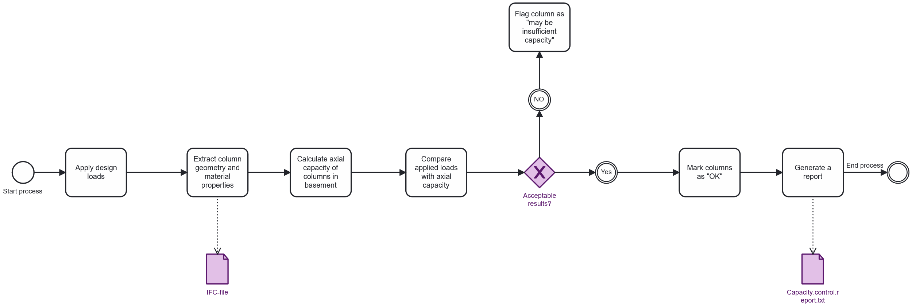
BPMN - tool

Slide 4
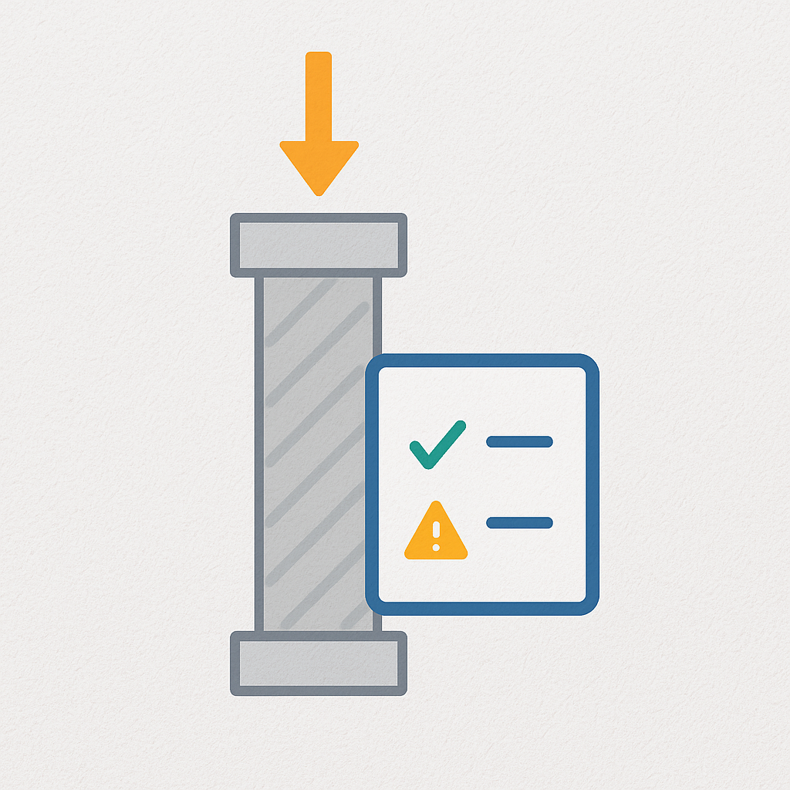




Aim of our tool
Evaluates axial load capacity of IFC Columns
Uses material, geometry, and Global ID
Checks loads from beams and slabs
Outputs a report: OK or Insufficient

Slide 5
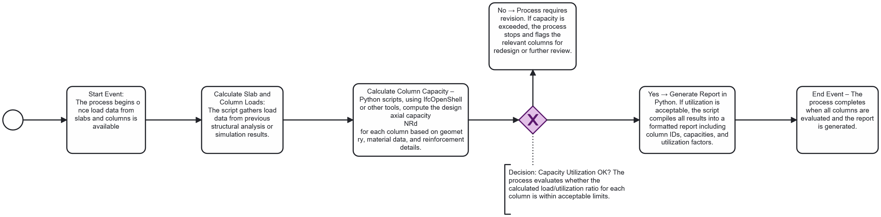
BPMN - workflow

Slide 6
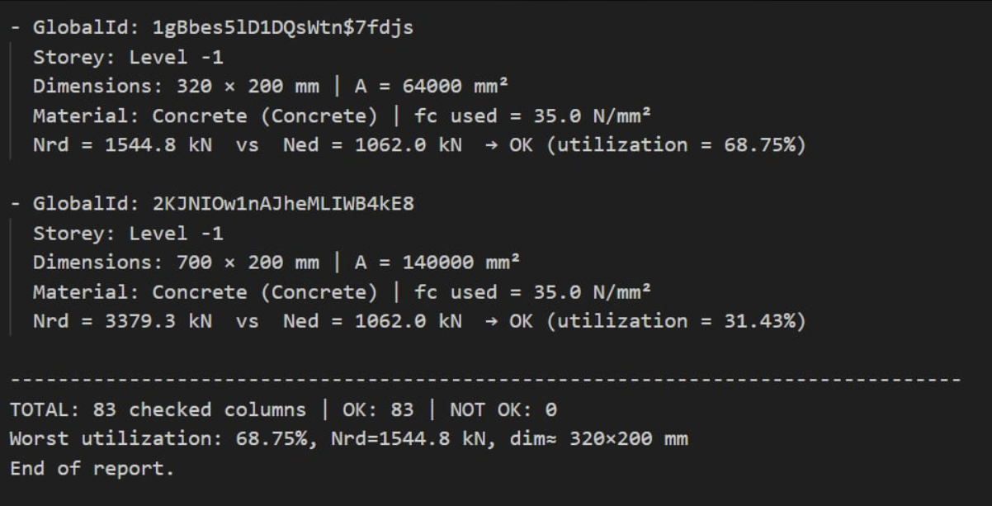
Output - "Capacity.control.report.txt"

